Slide 1


Slide 2

FRONTEND ENGINEERING-II EVALUATION-1
TEAM MEMBERS | TASK DONE
Kritica (2210990523) | Theme Changing Button: Designed and implemented JavaScript code to enable users to change the website's theme dynamically.
Kritika Bansal (2210990524) | API Data Graph: Implemented JavaScript code to integrate real-time data from an API and visualize it dynamically using interactive graphs.
Lavika Singla (2210990540) | Responsive Website: Developed JavaScript code to ensure the responsiveness of the website across various devices and screen sizes.
Project name: Stock Market Dashboard
Programming tools: HTML, CSS, JavaScript, Coin Gecko (API), VS Code Editor
Presented to: Baljit Mam and Vikas Sir
Dated: 11 March, 2024 – 15 March, 2024

Slide 3
introduction
In today's rapidly evolving financial landscape, staying informed and making timely decisions are paramount for investors, traders, and financial professionals.
Introducing our Stock Market and Crypto Dashboard. It's like a control center for your investments, personal expenses and income. You can see what's happening with your stocks and cryptocurrencies. It helps you make smart decisions about buying and selling. Whether you're a seasoned investor or just starting out, our user-friendly dashboard equips you with real-time insights, analysis, and tools to navigate both traditional and emerging asset classes with confidence.

Slide 4
Problem statement
If an admin does not have a stock market dashboard, they may encounter several challenges in managing and analyzing stock market data. They might resort to manual methods, use different data sources, and work with outdated information. This can slow down decision-making, reduce productivity, and lead to more mistakes.
This is why we have incorporated API based real-time data fetching graph in our project to help overcome this problem. APIs play a crucial role in enabling admins to access, manage, and analyze stock market data effectively. By leveraging APIs, admins can automate data retrieval, centralize data management, receive real-time updates, integrate with analytical tools, scale operations, ultimately empowering them to make informed decisions and drive business success in dynamic and competitive markets.

Slide 5
Key features
Real-Time Monitoring: Real-time data graphs of Bitcoin and Ethereum enables admin to monitor price movements, trends, and market sentiment in these cryptocurrencies. This real-time information is crucial for making timely investment decisions and capitalizing on market opportunities.
Investments Panel: The investments panel provides users with a consolidated view of their investment portfolios, including stocks. Users can track the performance of their investments, monitor asset allocations, and assess overall portfolio diversification.
Recent Transaction Panel: The recent transaction panel displays a history of recent transactions, including purchases, sales, transfers, and withdrawals. This feature helps users track their transaction history, reconcile account balances, and identify any suspicious or unauthorized activity.
Fast Payment Panel: The fast payment panel presents a streamlined interface featuring various options such as gas, electricity, internet, food, and more.

Slide 6
Programming tools
The HTML code provides a structured layout for a comprehensive stock market dashboard, including navigation, data visualization, and user interaction functionalities.
The CSS code provides a comprehensive styling structure for a web application, making use of CSS variables, flexbox, grid layout, transitions, and media queries for responsiveness.
The JavaScript code integrates real-time cryptocurrency price data into a dynamic and interactive chart, enhancing user experience and providing valuable insights for investors and traders. Additionally, it offers user-friendly features such as sidebar navigation and theme customization to improve usability.

Slide 7
Project Highlights
Theme Change: Allowing users to switch between light and dark themes caters to individual preferences and enhances user experience. Some users may prefer a light theme for readability during the day, while others may opt for a dark theme for reduced eye strain during nighttime usage.
Responsive website: A responsive design ensures that the dashboard adapts seamlessly to different screen sizes and devices, including desktops, laptops, tablets, and smartphones. This feature enhances accessibility and usability by providing a consistent user experience across various devices and platforms.
API Integration for Cryptocurrency Data: Incorporating an API graph of Bitcoin and Ethereum enables users to access real-time cryptocurrency market data directly within the dashboard. Interactive graph allows users to explore cryptocurrency market data, analyze historical trends, and identify patterns or anomalies. Users can zoom in, pan, and interact with the data to gain deeper insights and understand Bitcoin and Ethereum price movements.

Slide 8
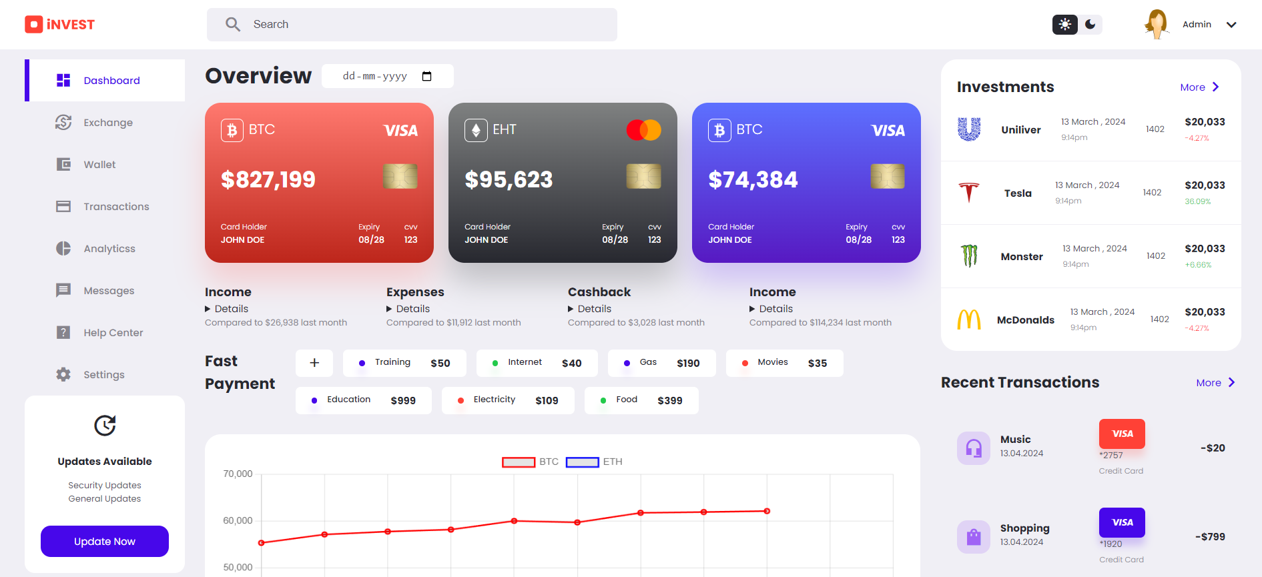
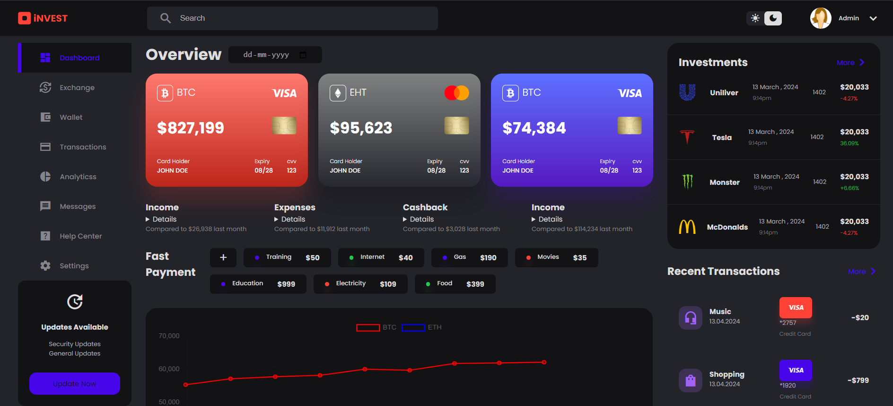
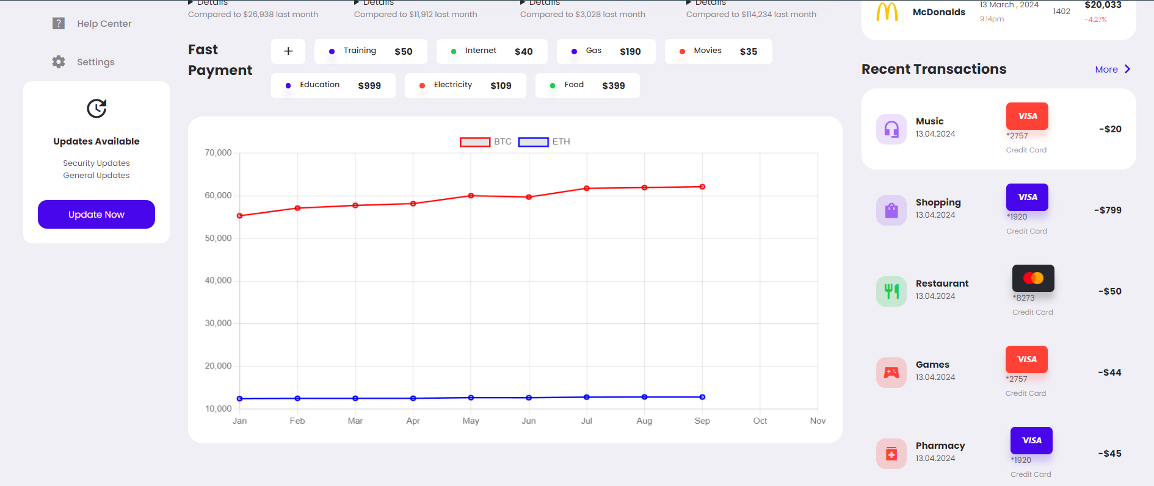
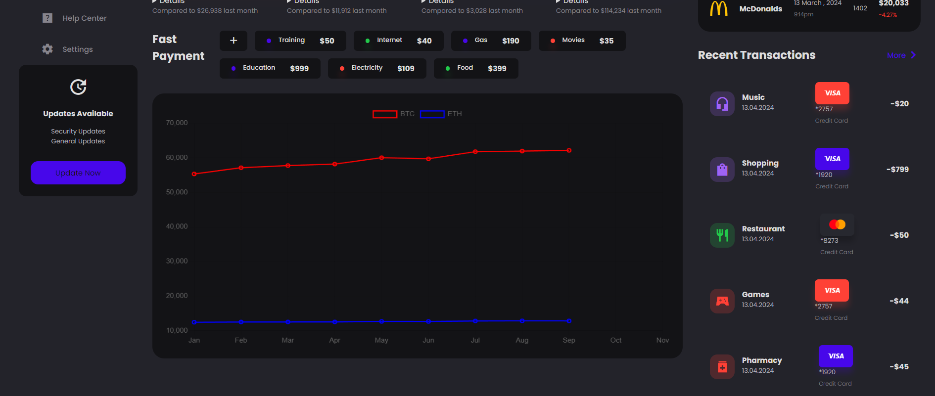
WEBSITE ON DESKTOP WITH LIGHT & DARK THEME

Slide 9
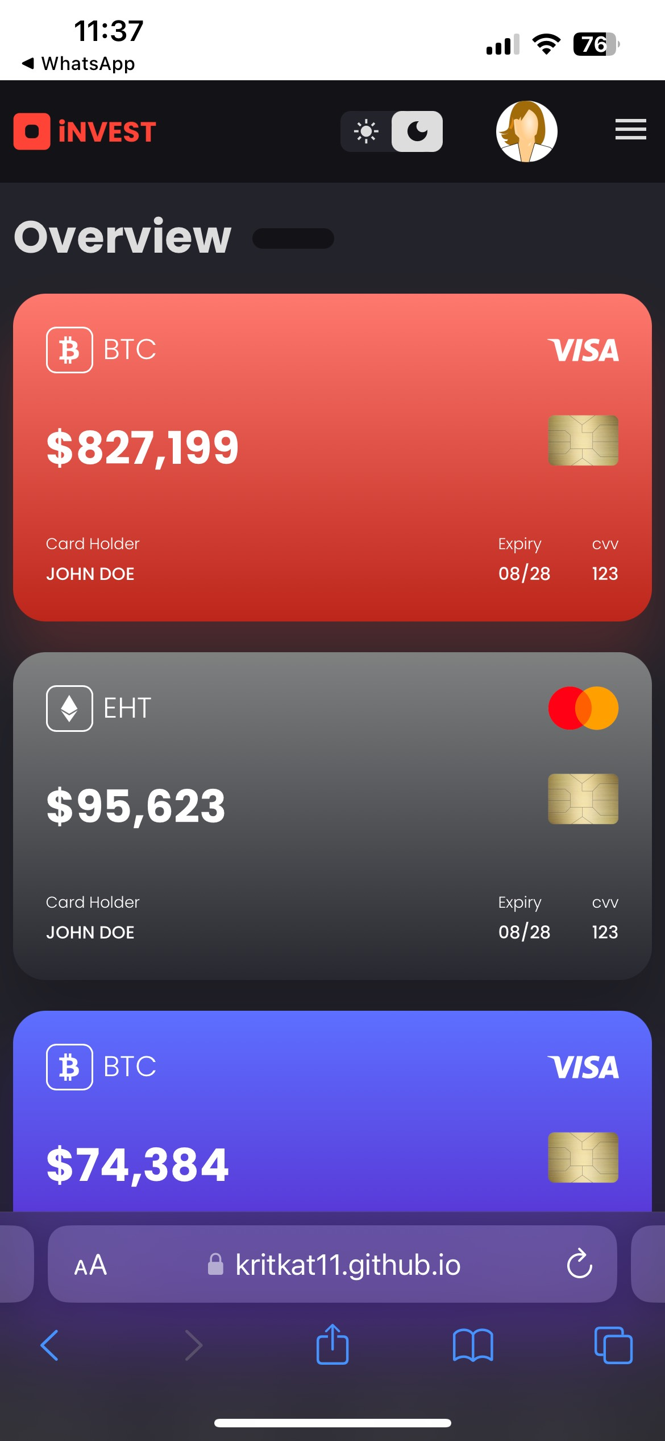
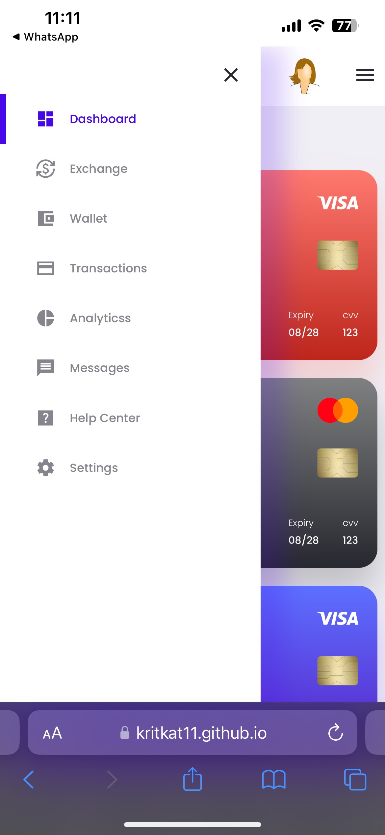
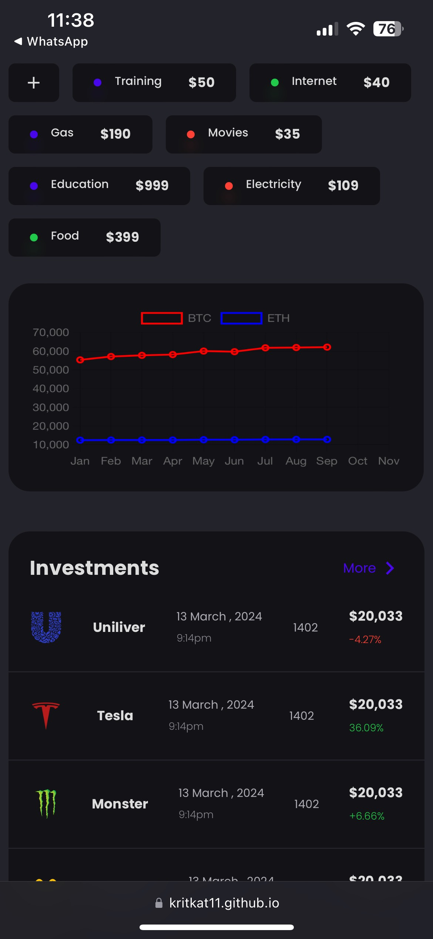
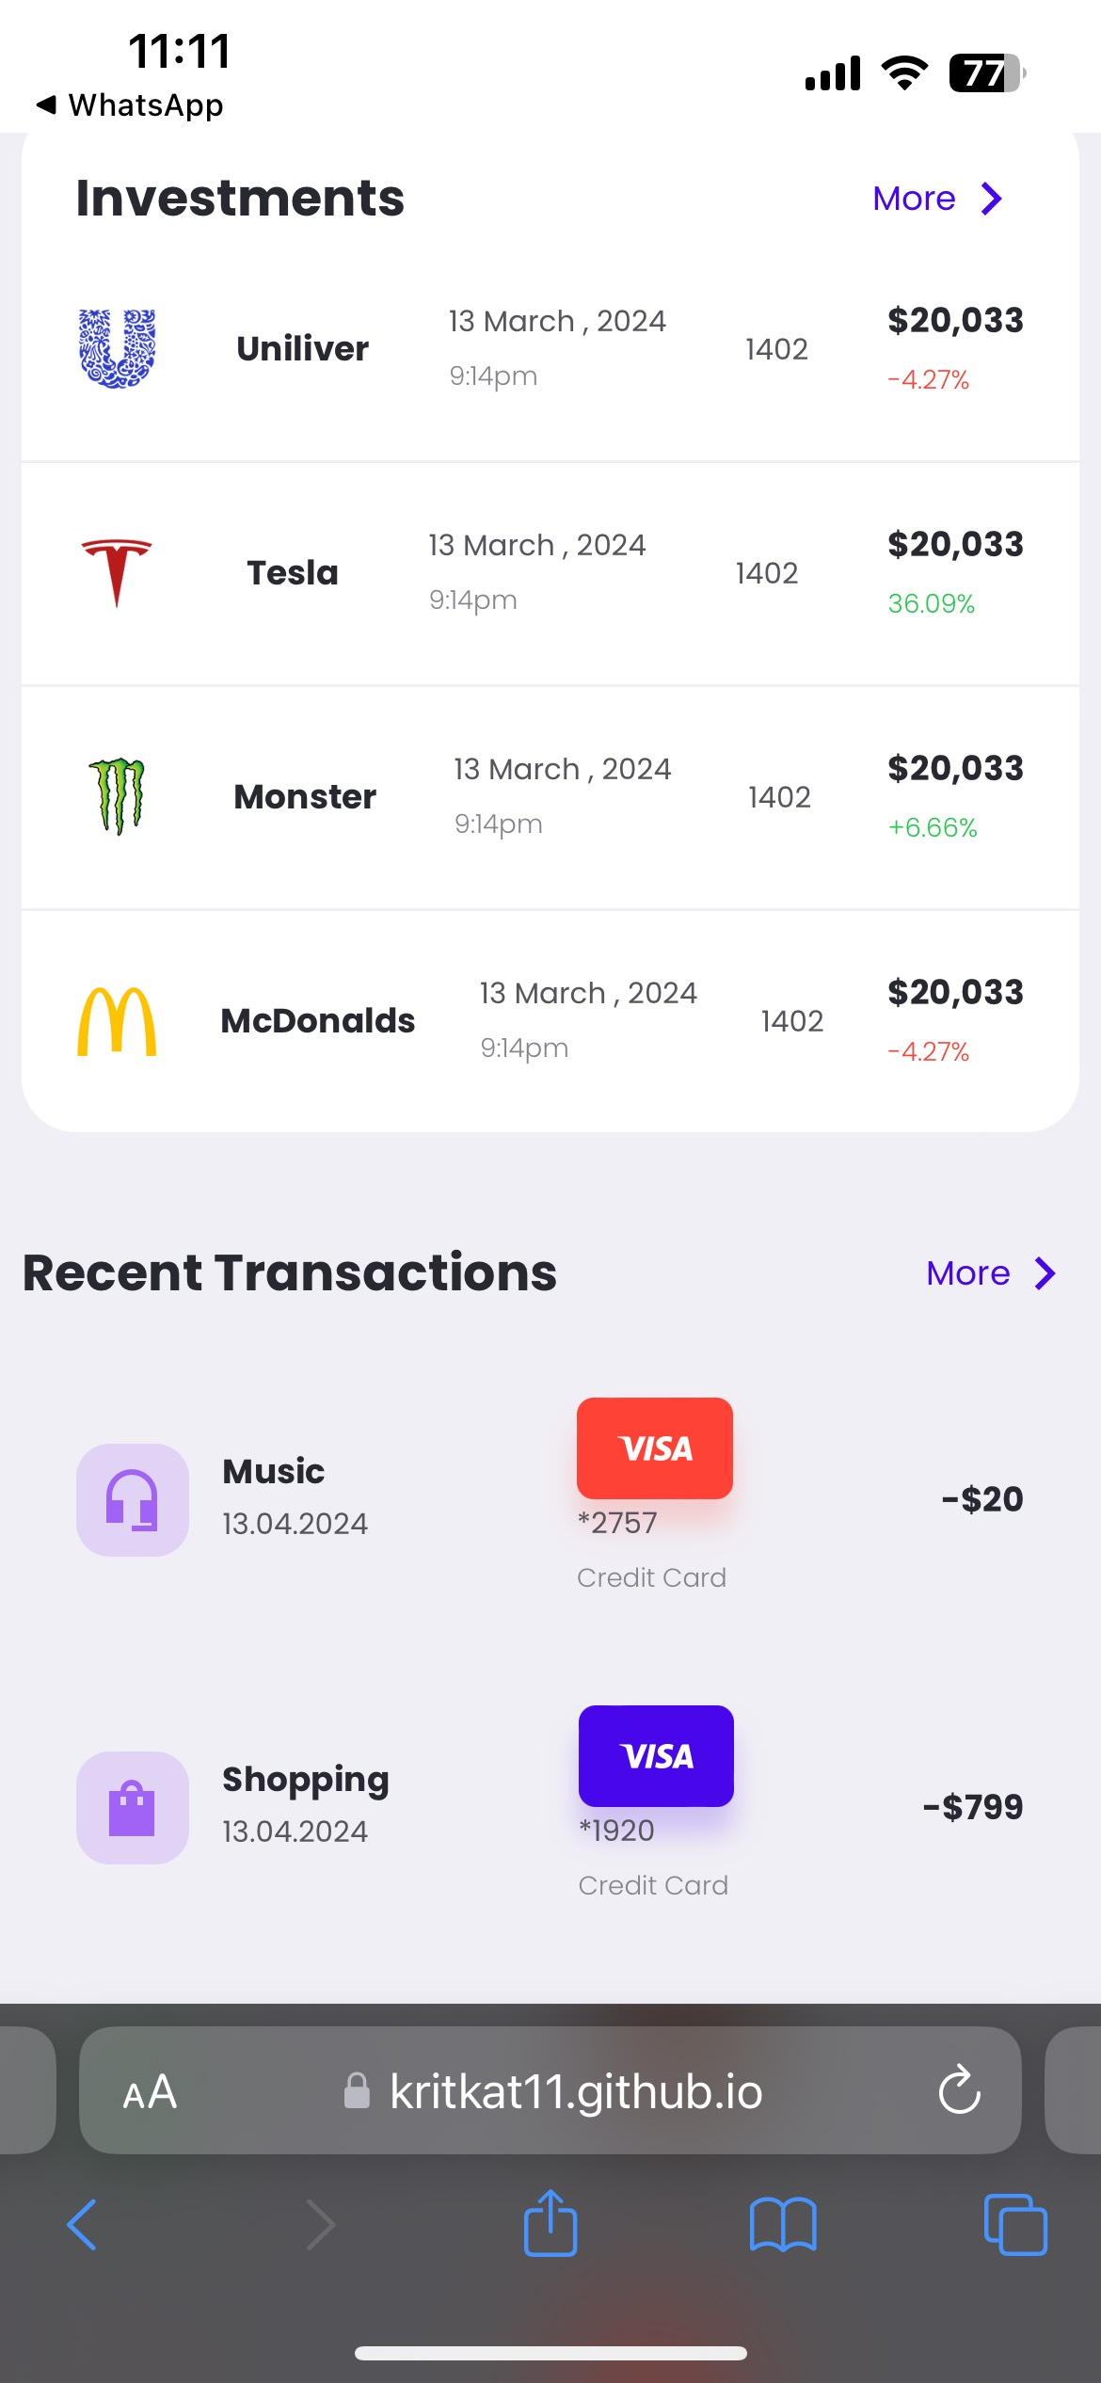
RESPONSIVE WEBSITE ON PHONE

Slide 10

References & links
https://www.w3schools.com/js/
https://www.coingecko.com/
https://fonts.google.com/
https://stackoverflow.com/

Slide 11
THANK YOU

